Slide 1
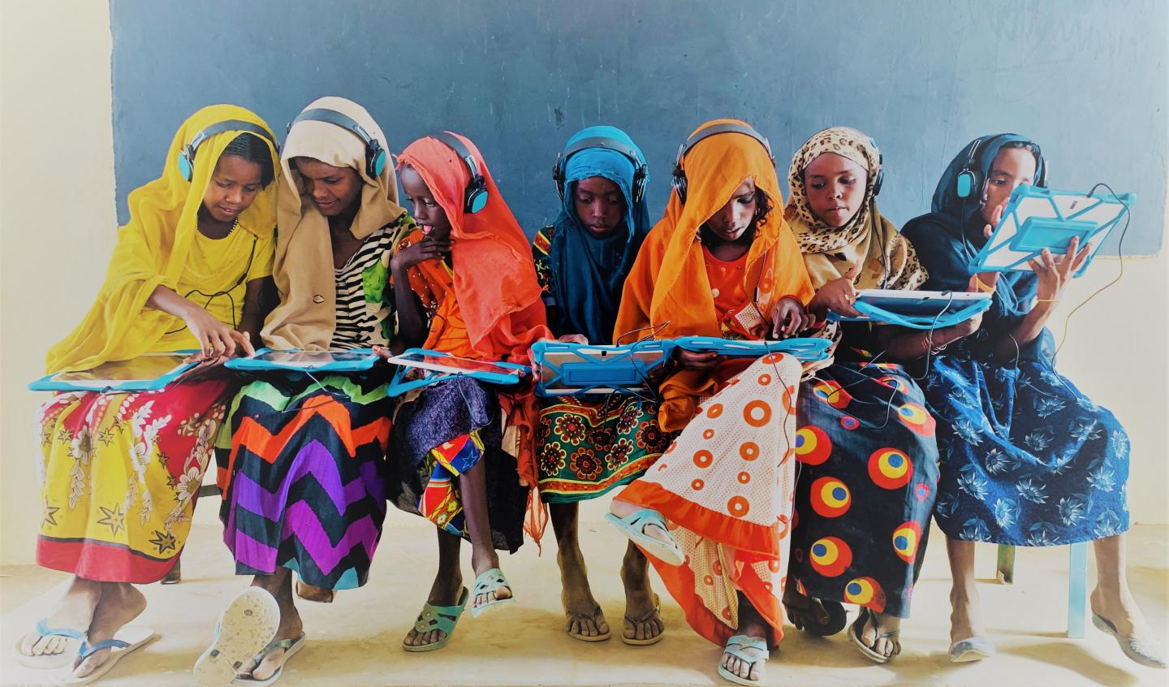
Report Of Education

Slide 2
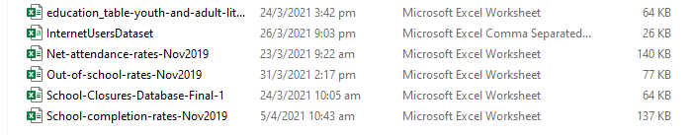
Data Source
www.unicef.org & https://www.kaggle.com/

Slide 3
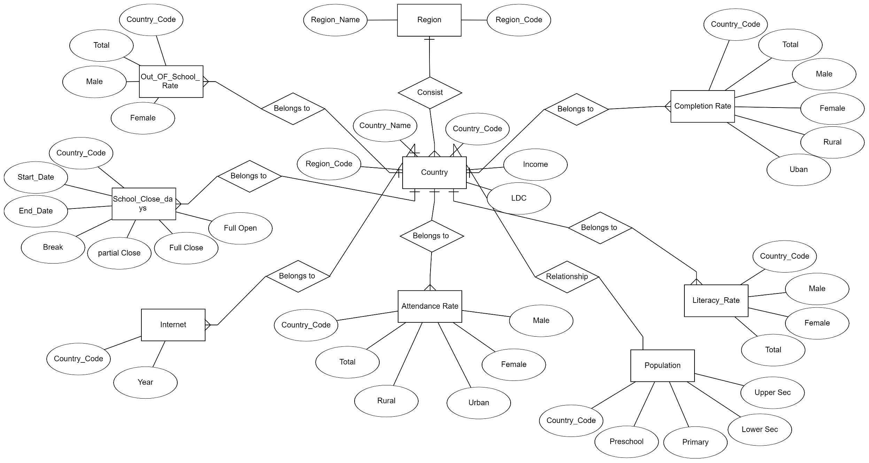
ER Diagram

Slide 4
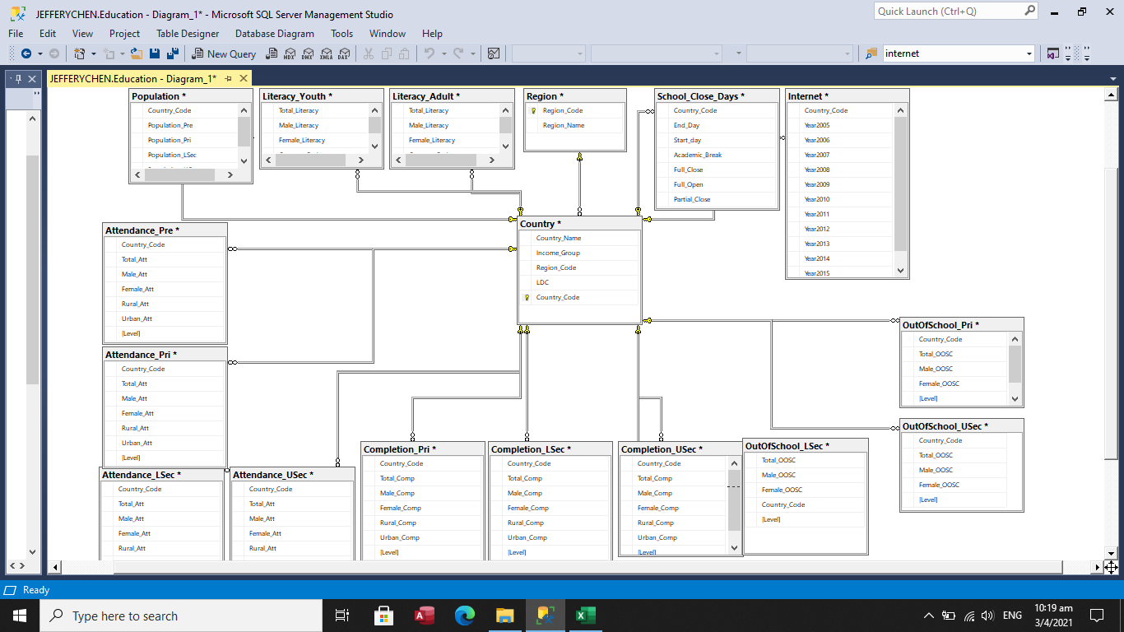
Schematic Diagram

Slide 5
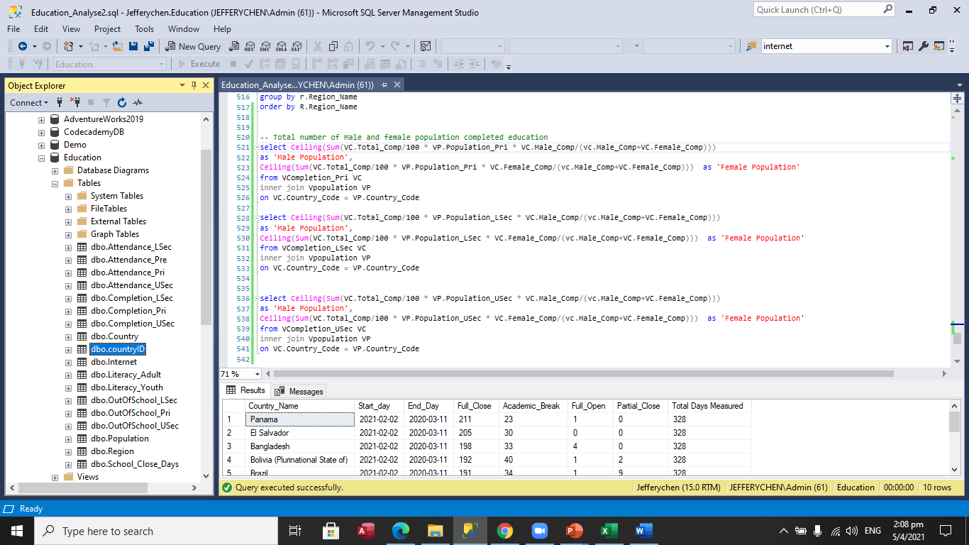
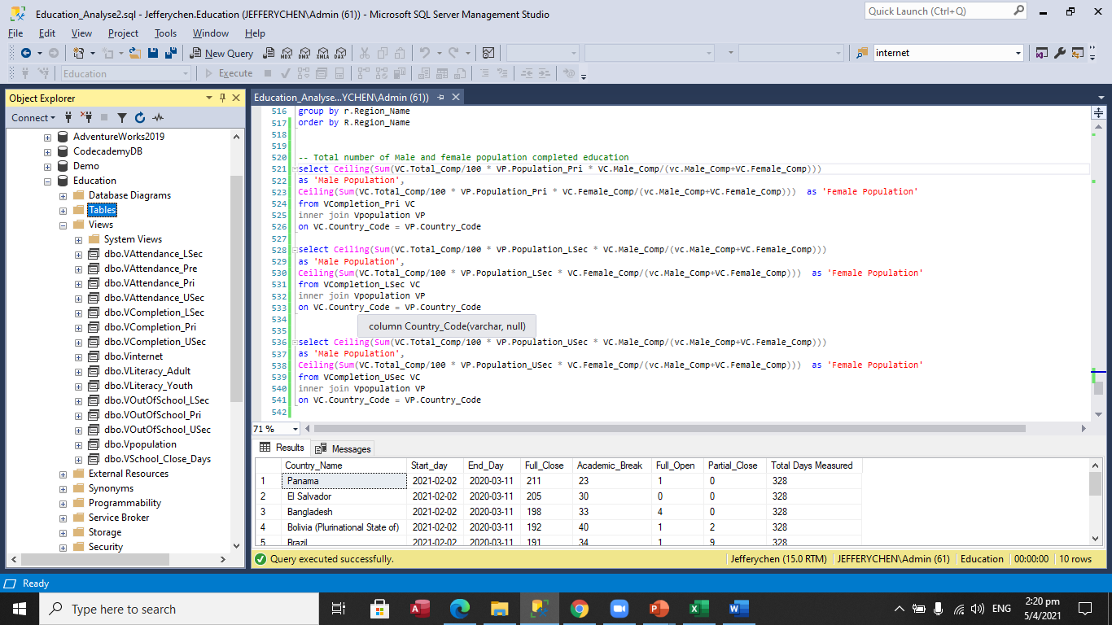
Database Design
Normalization: break big table into smaller tables and link them by Primary Key and Foreign Keys
Create Views for ease of analyzing data without changing the original data source

Slide 6
Introduction
Unicef - Charity Organization full name as United Nations Children’s Fund
Help to prevent millions of children and women from child labor, support health, safety and education
collect and study lots of data and facts, raise the awareness of unfortunate children who are in dangerous situations
Unicef has a long-term Education Strategy of helping every child to get education by 2030, by achieving three distinct goals:
Equitability access to leaning opportunities
Improve learning and skills
Improved learning and protection for children in emergencies and fragile contexts.
Dashboard

Slide 7
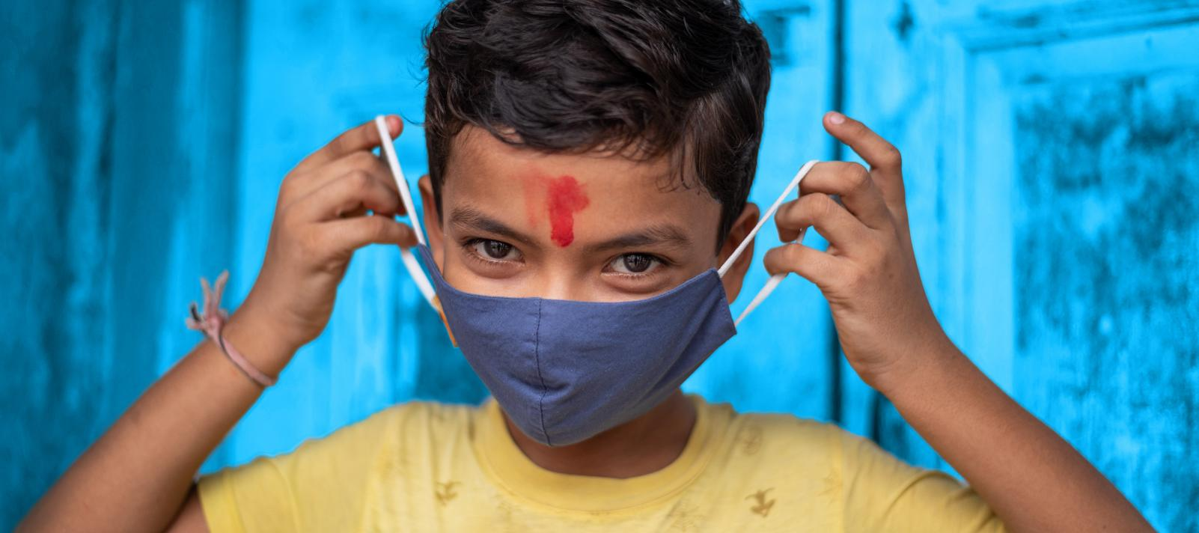
Conclusion
Every child has the right to learn!
The gap between level of learning in high income countries and low income countries are large and keep growing
For every child to learn, we need to provide more support on regions like Africa and South Asia
Many girls are still not getting equal opportunity to learn especially in low income countries
Covid19 has changed our way of learning. In order to provide equability in learning, internet infrastructure become essentially important, especially in low income countries.

